Slide 1


Wayanamac Education Trust ®
DON BOSCO INSTITUTE OF TECHNOLOGY
Kumbalagodu, Mysore Road, Bengaluru – 560074
www.dbit.co.in Ph: +91-80-28437028/29/30 Fax: +91-80-28437031
Department of CSE (Artificial Intelligence and Machine Learning)
Technical Seminar on
DDoS Attack Intrusion Detection System Based on Hybridization of CNN and LSTM
2023-24
8th Semester
BE in CSE(AI & ML)
UNDER THE GUIDENCE:
Mr. Sanjay Kumar
Associate Professor
Department of CSE(AI & ML)
PRESENTED BY:
NIDHI SINHA
1DB20CI029

Slide 2
DDoS Attack Intrusion Detection System
Finding a solution to the rising threat of DDoS attacks.
Problem Statement
The threat of DDoS attacks is on the rise, and current intrusion detection systems are not sufficient.Distributed Denial-of-Service (DDoS) attacks pose a significant cyber threat by inundating servers or networks with excessive traffic, rendering them inaccessible to legitimate users. These attacks result in substantial disruptions and financial harm to businesses and organizations. Their sophistication is on the rise, making detection a formidable challenge. Conventional intrusion detection systems (IDS) often struggle to identify intricate DDoS attacks, particularly those that disperse attack traffic across numerous sources.

Slide 3
Literature Survey
- 2017: A. S. Ahmed Issa et al. proposed a feature selection approach combining DDoS Characteristic Features (DCF) and Consistency Subset Evaluation (CSE) for IDS enhancement using machine learning.
- 2018: Kushwah and Ali introduced an ANN and black hole optimization approach for DDoS attack detection in cloud computing.
- 2019: Anjum and Shreedhara presented a Semi-Supervised Machine Learning technique to improve DDoS attack detection performance.
- 2020: Bagyalakshmi and Samundeeswari proposed filter and dimensionality reduction methods combined with various classification algorithms for effective DDoS attack detection.
- 2023: A study by A. S. Ahmed Issa et al. introduced a DDoS Attack Intrusion Detection System based on hybridization of CNN and LSTM.
- 2024: Azizi and Hosseini suggested a hybrid framework for DDoS detection, incorporating process classification to improve organizational efficiency.
- Prathyusha and Kannayaram highlighted the efficacy of artificial immune systems (AIS) for DDoS detection in cloud computing environments.

Slide 4
The Literature Survey
distributed denial-of-service (DDoS) attack
Signature-based methods: These methods rely on pre-defined signatures of known DDoS attacks. However, they are ineffective in detecting new or zero-day attacks.
Anomaly-based methods:These methods identify traffic patterns that deviate from normal baseline behavior. However, they can suffer from high false positive rates, meaning they may mistakenly identify normal traffic as an attack.
The proposed model was tested using the NSL-KDD dataset and achieved an impressive accuracy of 99.20%. This outperformed previous work and demonstrated the effectiveness of the deep learning approach in detecting DDoS attacks.

Slide 5
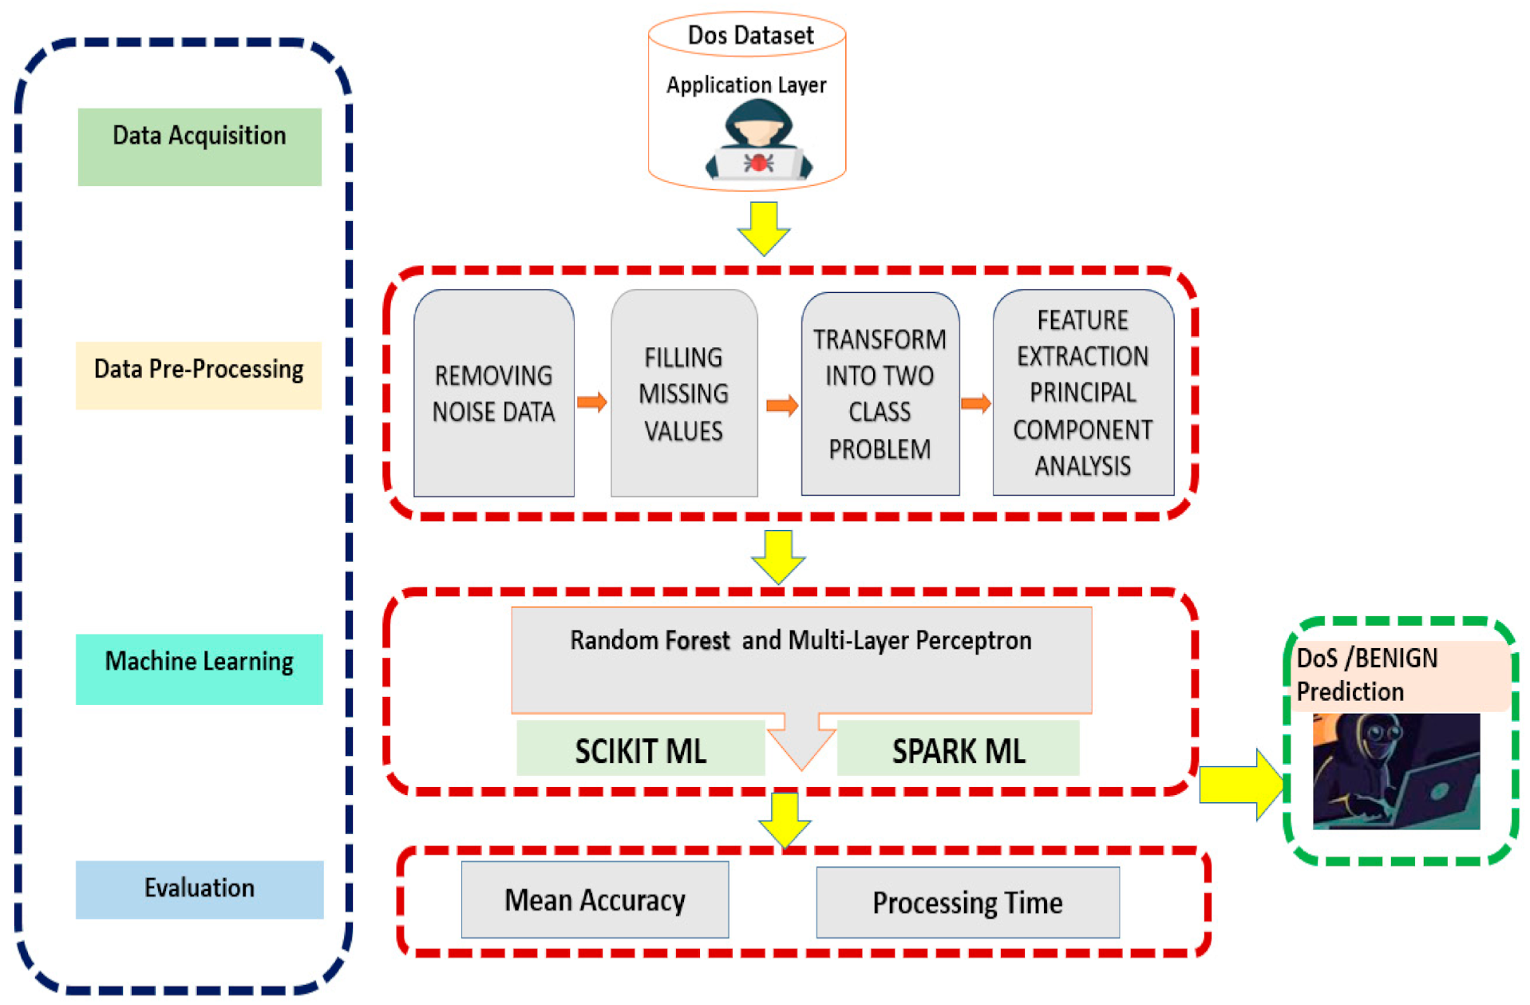
Block Diagram

Slide 6
Proposed Solution
The research paper proposes a new deep learning classification method that combines Convolutional Neural Networks (CNN) and Long Short-Term Memory (LSTM) for DDoS attack detection.
CNNs are effective at extracting features from sequential data, such as network traffic data. They can identify patterns in the data that may be indicative of an attack.
LSTMs are a type of recurrent neural network (RNN) that can learn long-term dependencies in data. This is important for DDoS attack detection, as attacks may unfold over time.
The proposed model combines the strengths of CNNs and LSTMs to achieve high accuracy in DDoS attack detection. The model consists of seven layers:
An input layer that pre-processes the data.
A convolutional layer that extracts features from the data.
A max pooling layer that reduces the number of parameters and helps prevent overfitting.
These convolutional and max pooling layers are repeated to learn more complex features.
An LSTM layer that learns long-term dependencies in the data.
A fully connected layer that classifies the data as a DDoS attack or normal traffic.

Slide 7
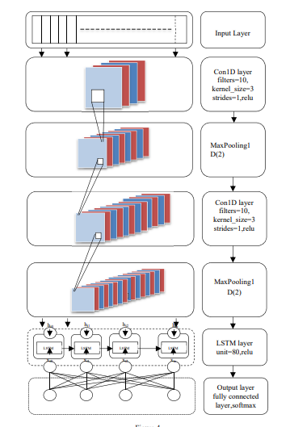

Slide 8
Tools Used for Implementation
Deep learning techniques:
Convolutional Neural Networks (CNNs)
Long Short-Term Memory (LSTM)
The specific software libraries used for implementation may not be mentioned in the research paper, but common libraries for deep learning include TensorFlow, PyTorch, and Keras.

Slide 9
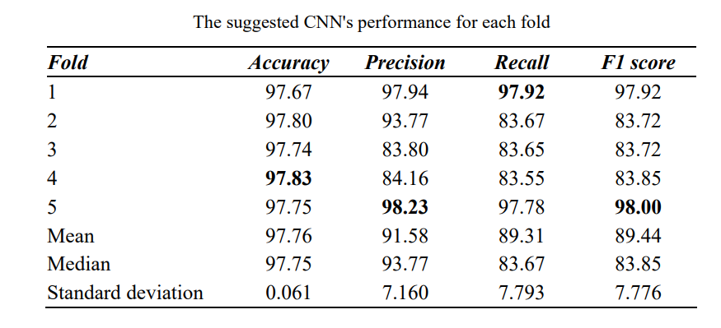
Result Analysis
The research paper reports that the proposed CNN-LSTM model achieved an accuracy of 99.20% on a standard benchmark dataset for DDoS attack detection.
This accuracy is higher than the accuracy achieved by other existing methods, such as CNN or LSTM used alone.

Slide 10
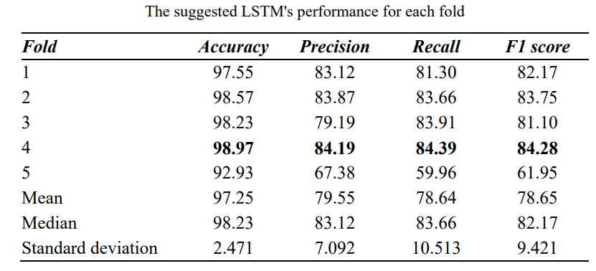
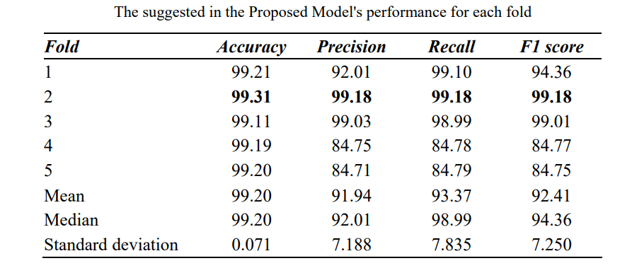
Resultant tables

Slide 11
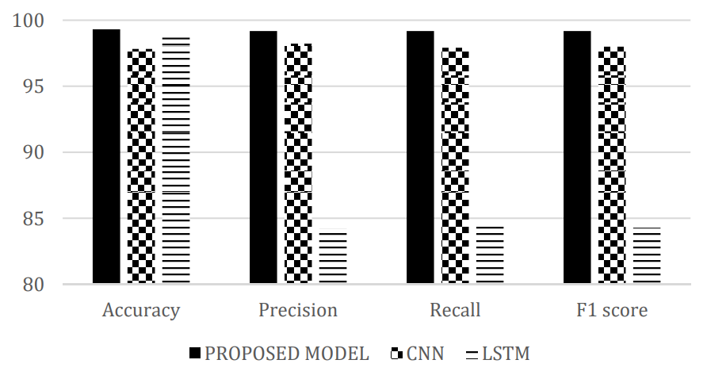
The performance comparison between CNN, LSTM, and the proposed model based on mean

Slide 12
Advantages
The proposed CNN-LSTM model offers several advantages over existing methods for DDoS attack detection:
High accuracy: The model achieves a high accuracy rate in detecting DDoS attacks.
Improved detection of complex attacks: The model can effectively detect complex DDoS attacks, including those that distribute traffic across multiple sources.
Ability to learn from data: The model can learn from new attack patterns and improve its detection accuracy over time.

Slide 13
Current Limitations
The research paper does not explicitly discuss limitations of the proposed model. However, some potential limitations of deep learning models in general include:
High computational cost: Training deep learning models can require significant computational resources.
Data dependency: The performance of deep learning models depends on the quality and quantity of training data.
Potential for overfitting: Deep learning models can overfit to training data, leading to poor performance on unseen data.

Slide 14
Applications
The proposed CNN-LSTM model can be used in a variety of real-world applications for DDoS attack detection, such as:
Protecting critical infrastructure, such as power grids and financial systems, from DDoS attacks.
Securing enterprise networks from DDoS attacks that can disrupt business operations.
Improving the security of cloud computing environments.

Slide 15
Conclusion
The research paper concludes that the proposed CNN-LSTM model represents a significant advancement in DDoS attack intrusion detection. By integrating the feature extraction capabilities of Convolutional Neural Networks (CNNs) with the long-term dependency learning of Long Short-Term Memory (LSTM) networks, the model demonstrates a high level of accuracy in identifying DDoS attacks, including complex ones with distributed traffic sources. This amalgamation addresses limitations observed in existing methods, particularly in detecting sophisticated attacks. Furthermore, the model's capacity to learn from data suggests potential adaptability to new attack patterns, thereby maintaining effectiveness over time. Overall, the CNN-LSTM hybrid model presents a promising avenue for enhancing DDoS attack detection and mitigating their impact on networks and systems.

Slide 16
Future Enhancement
Incorporate additional features: The model currently focuses on network traffic data. It could be further improved by incorporating additional features, such as flow rate, packet size distribution, and destination IP addresses.
Explore transfer learning: Transfer learning techniques could be used to leverage the model's capabilities for detecting other types of cyber attacks.
Investigate real-time detection: The current research focuses on offline detection. Future work could explore adapting the model for real-time detection of DDoS attacks.
Test against adversarial attacks: Adversarial machine learning techniques could be used to test the robustness of the model against attackers who try to evade detection.
Large-scale deployment: The research evaluates the model on benchmark datasets. Future work could involve deploying the model in real-world network environments and evaluating its performance at scale.

Slide 17
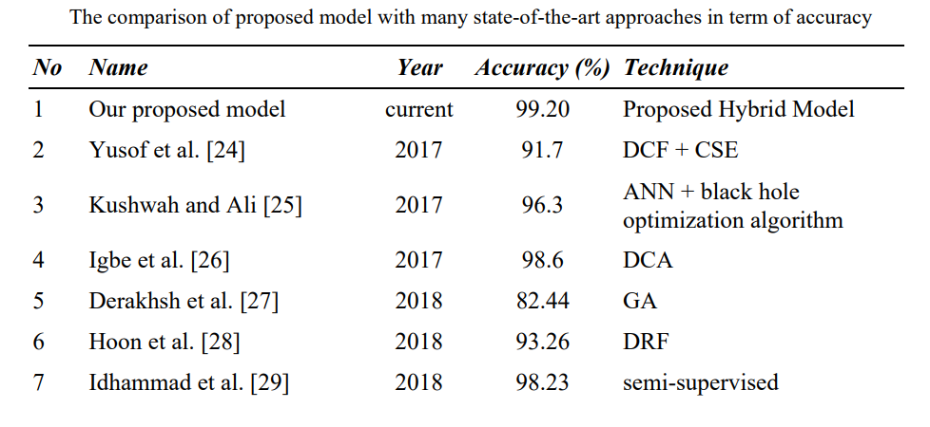

Slide 18
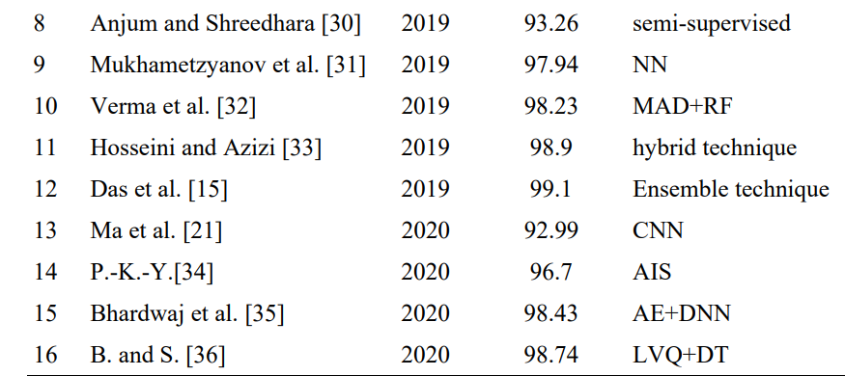

Slide 19
References
[1] Bharot, N. et al.: DDoS Attack Detection and Clustering of Attacked and Non-attacked VMs Using SOM in Cloud Network. In: International Conference on Advances in Computing and Data Sciences. Springer, 2019, pp. 369-378
[2] Baykara, M., Das, R.: A Novel Hybrid Approach for Detection of WebBased Attacks in Intrusion Detection Systems. International Journal of Computer Networks and Applications, 4(2), 2017, pp. 62-76
[3] ISSA, Ahmed Sardar Ahmed, and Zafer ALBAYRAK. "CLSTMNet: A Deep Learning Model for Intrusion Detection." Journal of Physics: Conference Series. Vol. 1973, No. 1, IOP Publishing, 2021
[4] Özalp, A. N et al.: Layer-based examination of cyber-attacks in IoT. International Congress on Human-Computer Interaction, Optimization and Robotic Applications (HORA), 2022, pp. 1-10
[5] Hyder, H. K., Lung, C. H.: Closed-Loop DDoS Mitigation System in Software Defined Networks. DSC 2018 - 2018 IEEE Conf. Dependable Secur. Comput., 2019, pp. 1-6
[6] Musotto, R., Wall, D. S.: More Amazon than Mafia: analysing a DDoS stresser service as organised cybercrime. Trends Organ. Crime, 2020

Slide 20


